Slide 1
MAKING COMPLEX DEClSlONS

Slide 2
Outline
MDPs(Markov Decision Processes)
  Sequential decision problems
  Value iteration & Policy iteration
POMDPs
  Partially observable MDPs
  Decision-theoretic Agents
Game Theory
  Decisions with Multiple Agents: Game Theory
  Mechanism Design

Slide 3
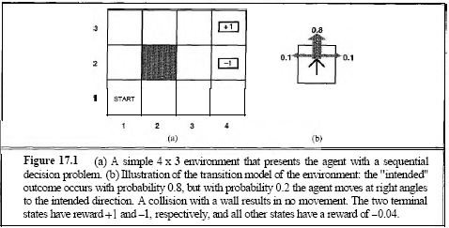
Sequential decision problems
An example

Slide 4
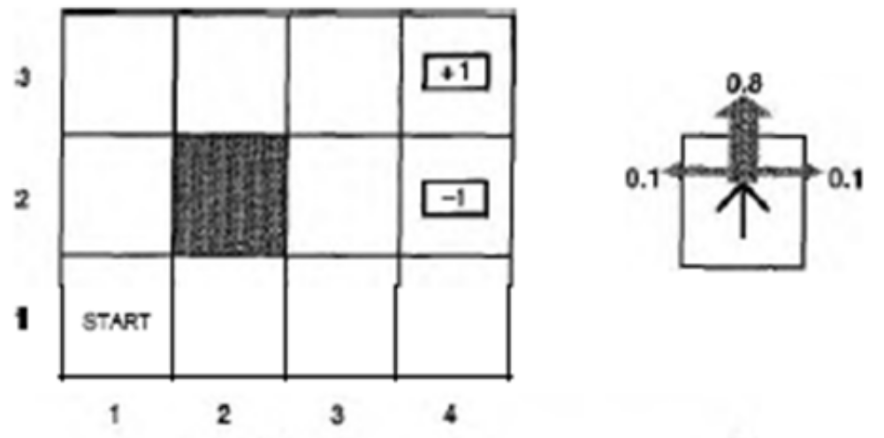
Sequential decision problems
Game rules:
4 x 3 environment shown
Beginning in the start state
Choose an action at each time step
End in the goal states, marked +1 or -1.
Actions : {Up, Down, Left, Right}
The environment is fully observable
Terminal states have reward +1 and -1,respectively
All other states have a reward of -0.04

Slide 5
Sequential decision problems
Each action achieves the intended effect with probability 0.8, but the rest of the time, the action moves the agent at right angles to the intended direction.
If the agent bumps into a wall, it stays in the same square.
3
2
1
1 2 3 4

Slide 6
Sequential decision problems
Transition model
  A specification of the outcome probabilities for each action in each possible state
Environment history
  a sequence of states
Utility of an environment history
  the sum of the rewards(positive or negative) received

Slide 7
Sequential decision problems
Definition of MDP
Markov Decision Process: The specification of a sequential decision problem for a fully observable environment with a Markovian transition model and additive rewards
An MDP is defined by
  Initial State: S₀
  Transition Model: T ( s , a, s')
  Reward Function: R(s)

Slide 8

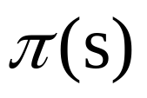
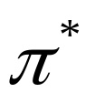
Sequential decision problems
Policy(denoted by )
  a solution which specify what the agent should do for any state that the agent might reach
is the action recommended by the policy for state s
Optimal policy(denoted by )
  a policy that yields the highest expected utility

Slide 9
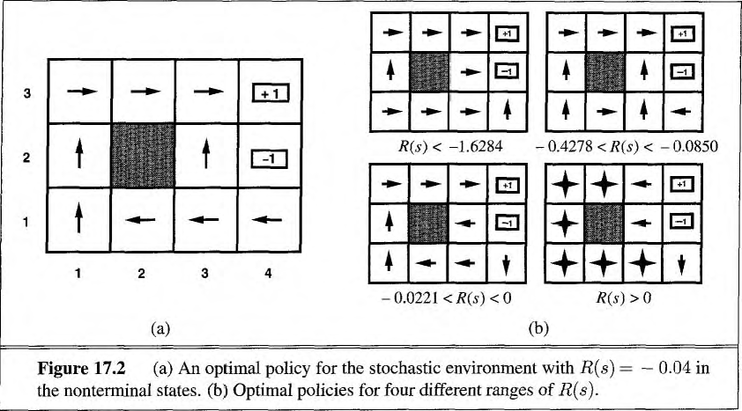
Sequential decision problems
An optimal policy for the world of Figure 17.1

Slide 10
Sequential decision problems
A finite horizon
  A finite horizon means that there is a fixed time N after which nothing matters-the game is over
  The optimal policy for finite horizon is nonstationary(the optimal action in a given state could change over time)
  Complex
An infinite horizon
  A finite horizon means that there is not a fixed time N after which nothing matters-the game is over
  the optimal policy for infinite horizon is stationary
  simpler

Slide 11
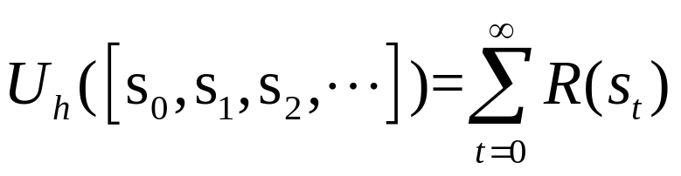
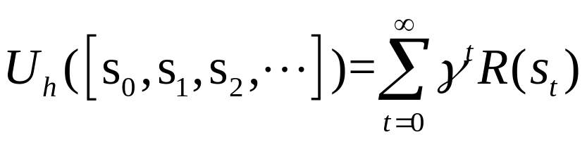
Sequential decision problems
Calculate the utility of state sequences
Additive rewards: The utility of a state sequence is
Discounted rewards: The utility of a state sequences is
where the discount factory γ is a number between 0 and 1

Slide 12
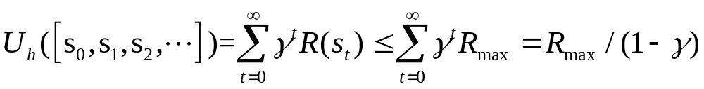
Sequential decision problems
Infinite horizons
Definition：A policy that is guaranteed to reach a terminal state is called a proper policy
  with proper policy, we may use γ =1
Another possibility is to compare infinite sequences in terms of the average reward obtained per time step

Slide 13

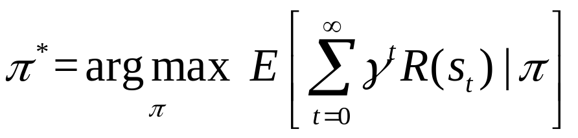
Sequential decision problems
How to choose between policies
  The value of a policy is the expected sum of discounted rewards obtained, where the expectation is taken over all possible state sequences that could occur, given that the policy is executed.
An optimal policy satisfies

Slide 14
Outline
MDPs(Markov Decision Processes)
  Sequential decision problems
  Value iteration & Policy iteration
POMDPs
  Partially observable MDPs
  Decision-theoretic Agents
Game Theory
  Decisions with Multiple Agents: Game Theory
  Mechanism Design

Slide 15
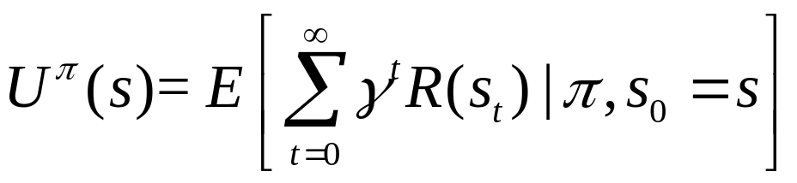




Value iteration
The basic idea is to calculate the utility of each state and then use the state utilities to select an optimal action in each state.
Definition: Utilities of states (given a specific policy π )
let be the state the agent is in after executing π for t steps (note that is a random variable)
Difference between
short term reword
long term reword

Slide 16
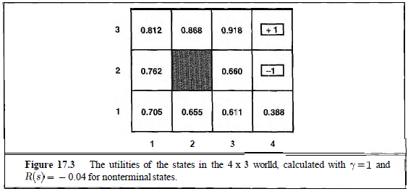
Value iteration
The utilities for the 4 x 3 world

Slide 17
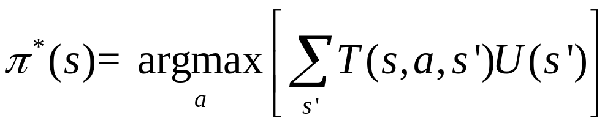
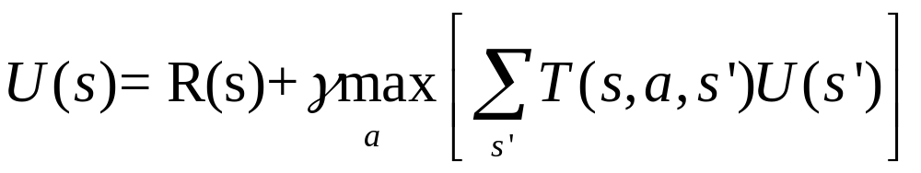
Value iteration
Choose: the action that maximizes the expected utility of the subsequent state
The utility of a state is given by Bellman equation

Slide 18
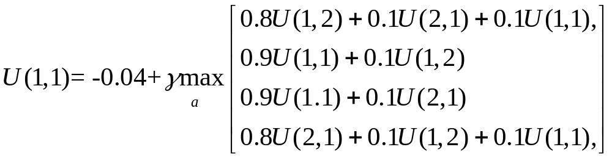
Value iteration
Let us look at one of the Bellman equations for the 4 x 3 world. The equation for the state (1,1) is
Up
Left
Down
right
3
2
1
1 2 3 4

Slide 19
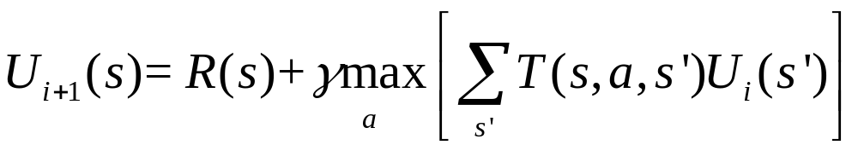
Value iteration
The value iteration algorithm a Bellman update, looks like this
VALUE-ITERATION algorithm as follows

Slide 20
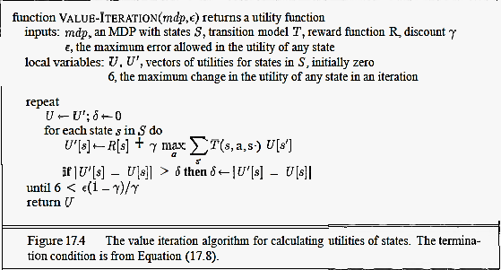
Value iteration

Slide 21
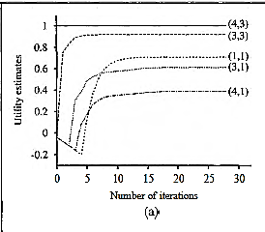
Convergence of Value iteration
Starting with initial values of zero, the utilities evolve as shown in Figure 17.5(a)

Slide 22

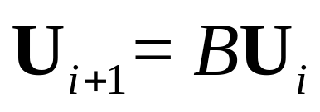
Value iteration
Two important properties of contractions:
  A contraction function has only one fixed point..
  When the function is applied to any argument, the value must get closer to the fixed point.
Let denote the vector of utilities for all the states at the i-th iteration. Then the Bellman update equation can be written as

Slide 23
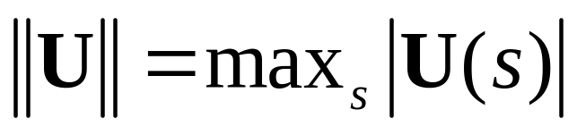

Value iteration
Use the max norm, which measures the length of a vector by the length of its biggest component:
Let Ui and Ui' be any two utility vectors. Then we have

Slide 24
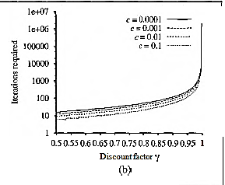
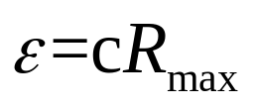
Value iteration
The number of value iterations k required to guarantee an error of at most for different values of c.

Slide 25
Policy iteration
The policy iteration algorithm alternates the following two steps, beginning from some initial policy π0 :
Policy evaluation: given a policy πi, calculate Ui = U^{πi}, the utility of each state if πi were to be executed.
Policy improvement: Calculate a new MEU policy πi+1, using one-step look-ahead based on Ui (as in Equation (17.4)).

Slide 26
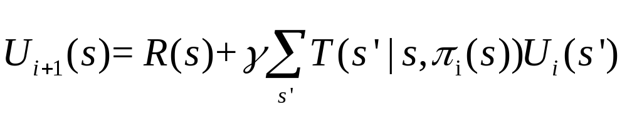
Policy iteration
For n states, we have n linear equations with n unknowns, which can be solved exactly in time O(n³) by standard linear algebra methods. For large state spaces, O(n³) time might be prohibitive
Modified policy iteration
The simplified Belllman update for this process

Slide 27
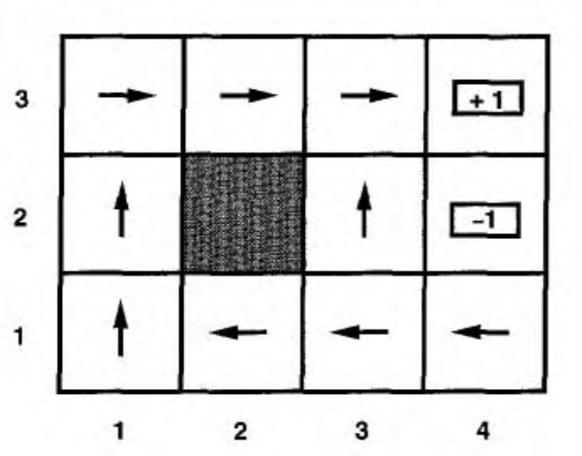

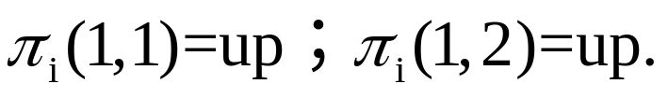
Policy iteration
Example：See the figure.
Suppose is the policy shown in the figure

Slide 28
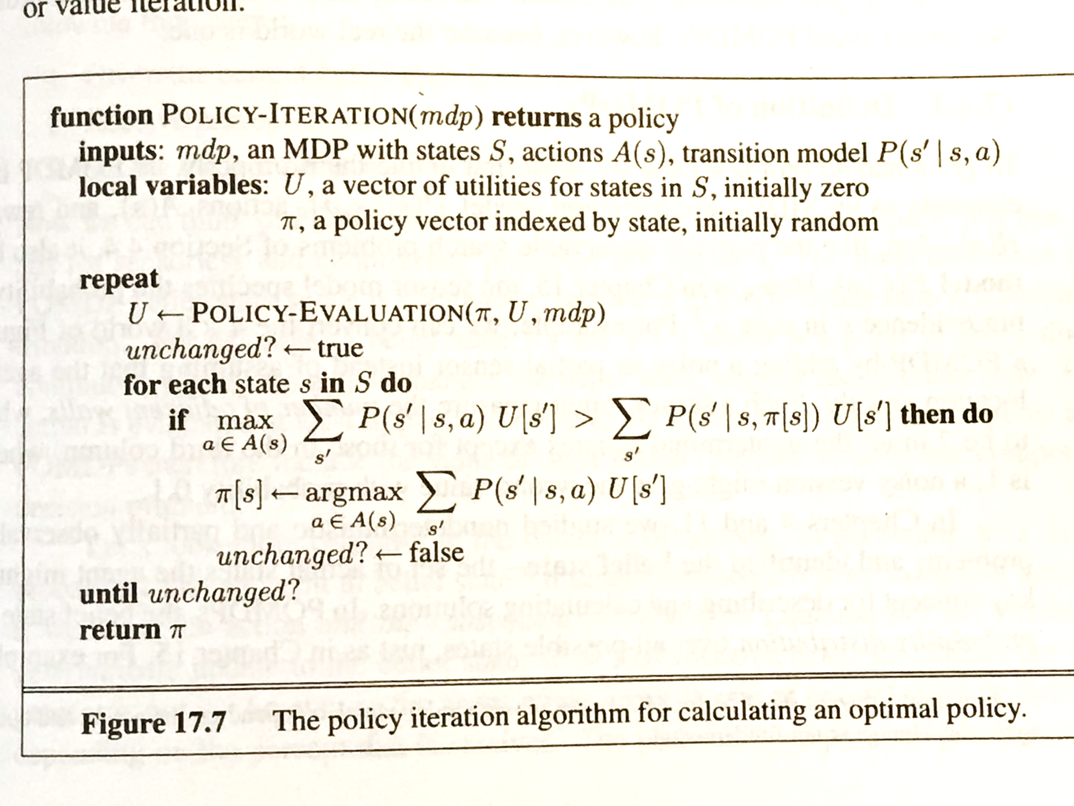
Policy iteration

Slide 29
Policy iteration
In fact, on each iteration, we can pick any subset of states and apply either kind of updating (policy improvement or simplified value iteration) to that subset. This very general algorithm is called asynchronous policy iteration.

Slide 30
Outline
MDPs(Markov Decision Processes)
  Sequential decision problems
  Value iteration & Policy iteration
POMDPs
  Partially observable MDPs
  Decision-theoretic Agents
Game Theory
  Decisions with Multiple Agents: Game Theory
  Mechanism Design

Slide 31
Partially observable MDPs
When the environment is only partially observable, MDPs turns into Partially observable MDPs(or POMDPs pronounced "pom-dee-pees")
POMDPs 's elements：
  elements of MDP（transition model、reward function）
  Observation model
An POMDP is defined by
  Initial State: S₀ ( also unknown)
  Transition Model: P ( s’| a, s)
  Reward Function: R(s)
  Sensor model P(e|s)

Slide 32
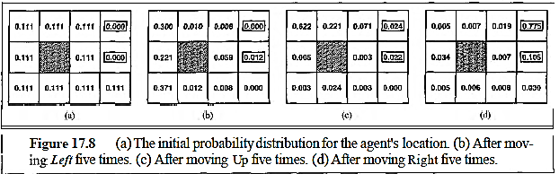
Partially observable MDPs
an example for POMDPs

Slide 33
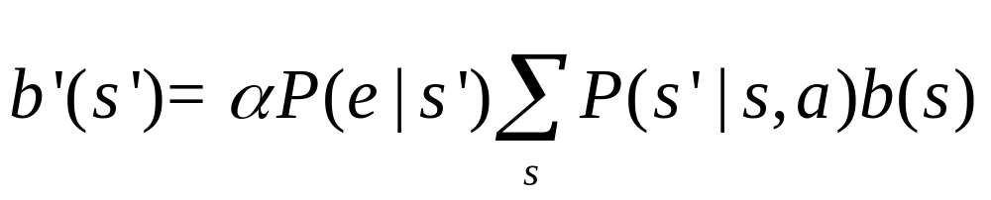


Partially observable MDPs
How to calculate belief state ?
where is a normalized term.
Suppose the agent move LEFT and its sensor reports it adjacent wall; then it’s quite likely that the agent is now in (3,1) under the motion and the sensor
are noisy

Slide 34
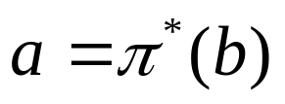
Partially observable MDPs
Decision cycle of a POMDP agent:
  Given the current belief state b, execute the action
  Receive observation e.
  Set the current belief state to FORWARD(b, a, e) and repeat.

Slide 35
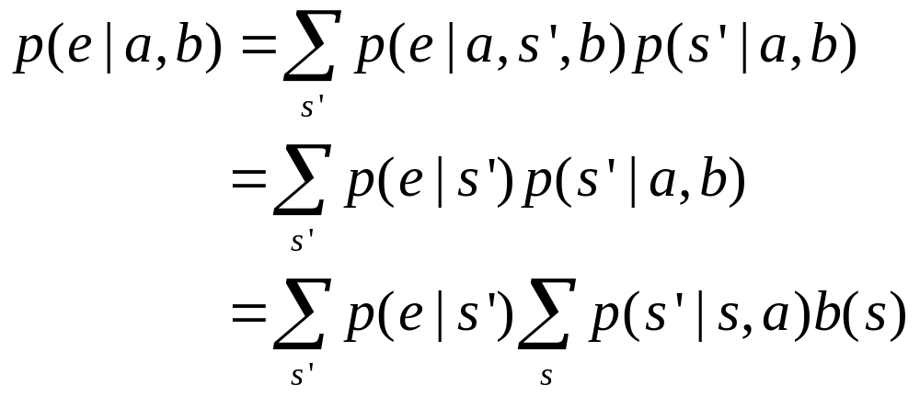
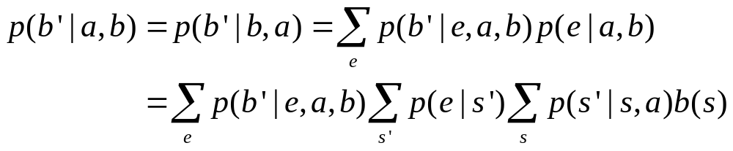
The probability of e
Given that a was performed starting in belief state b, the probability of e

Slide 36


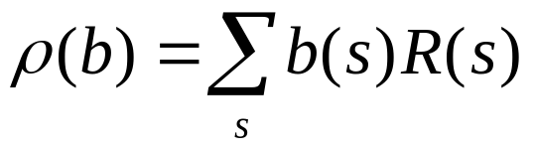
The probability of e
where if , =0, otherwise.
Reward function:
Thus define an observable MDP on the space of belief state. Solving a POMDB on a physical state space can be reduced to solving an MDP on the corresponding belief-state space.

Slide 37
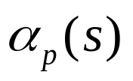
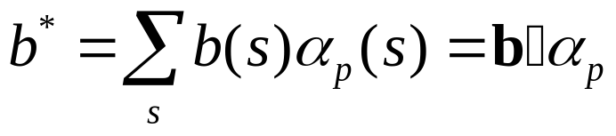
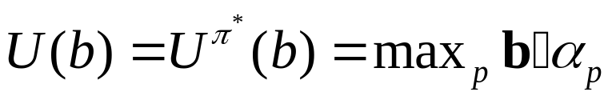
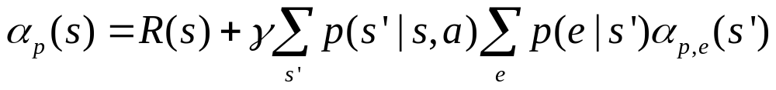
Value Iteration for POMDPs
Denote the utility of executing a fixed conditional plan p in physical state s. The expected utility of executing p in the belief state is
The expected utility of b under optimal policy is the utility of that conditional plan
The Utility iteration

Slide 38
Outline
MDPs(Markov Decision Processes)
  Sequential decision problems
  Value iteration & Policy iteration
POMDPs
  Partially observable MDPs
  Decision-theoretic Agents
Game Theory
  Decisions with Multiple Agents: Game Theory
  Mechanism Design

Slide 39
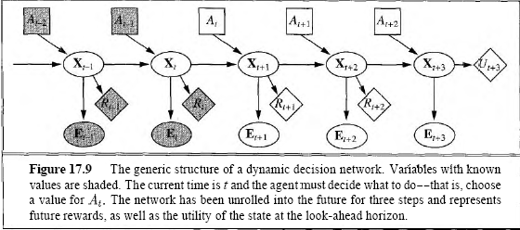
Decision –theoretic Agents
Basic elements of approach to agent design
  Dynamic Decision network(DDN=DBN+Utility)
  A filtering algorithm & Make decisions
A dynamic decision network as follows:

Slide 40
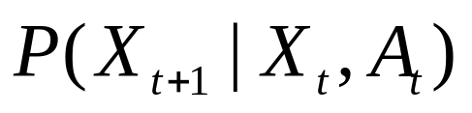
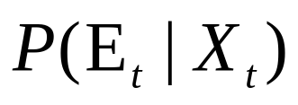

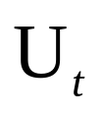
Decision –theoretic Agents
Dynamic Decision network(DDN=DBN+Utility)
  Transition model:
  Sensor model：
  Reward:
  Utility:

Slide 41
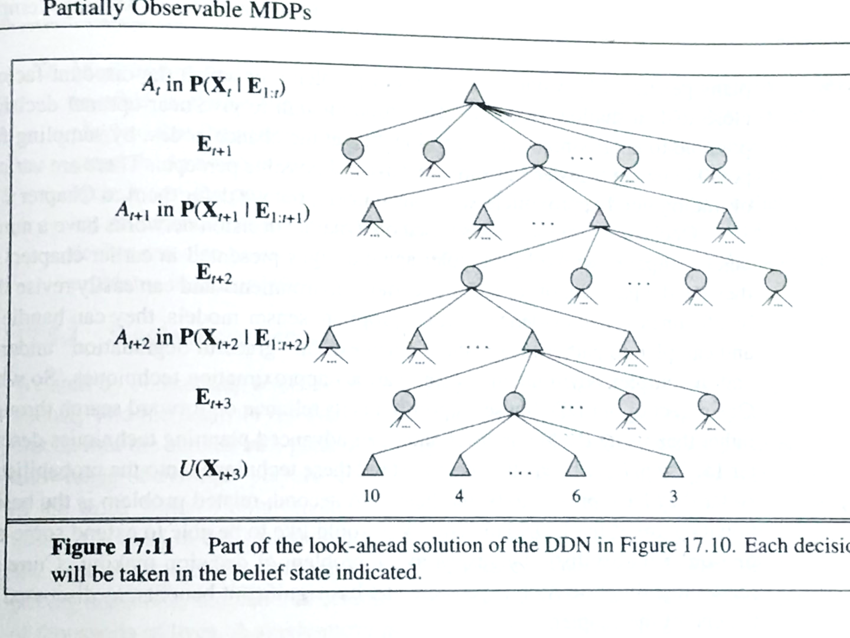
Decision –theoretic Agents
Part of the look-ahead solution of the DDN

Slide 42
Outline
MDPs(Markov Decision Processes)
  Sequential decision problems
  Value iteration & Policy iteration
POMDPs
  Partially observable MDPs
  Decision-theoretic Agents
Game Theory
  Decisions with Multiple Agents: Game Theory
  Mechanism Design

Slide 43
Game Theory
Components of a game in game theory
  Players: Alice, Bob
  Actions: one , testify
  A payoff function
  The payoff matrix for two finger Morra:
 | O: one | O: two
E: one | E=+2; O= -2 | E= -3; O= +3
E: two | E=-3; O= +3 | E=+4; O= -4

Slide 44
Game Theory
Agent design:
  To analyze the agent’s decisions and compute the expected utility for each decision under assumption that other agents are acting optimally according to game theory.
Mechanism design:
  When an environment is inhabited by many agents, it might be possible to define the rules of the environment so that the collective good of all agents is maximized when each agent adopts the game-theoretic solution that maximizes its own utility
  Example: Internet traffic routers

Slide 45
Game Theory
Strategy of players
  Pure strategy(deterministic policy)
  Mixed strategy(randomized policy)
Strategy profile
  an assignment of a strategy to each player
Solution
  a strategy profile in which each player adopts a rational strategy.

Slide 46
Game Theory
Game theory describes rational behavior for agents in situations where multiple agents interact simultaneously.
Solutions of games are Nash equilibria - strategy profiles in which no agent has an incentive to deviate from the specified strategy.

Slide 47
Prisoner’s Dilemma
 | Alice: testify | Alice: refuse
Bob:testify | A=-5; B= -5 | A= -10; B= 0
Bob:refuse | A=0; B= -10 | A= -1; B= -1
Suppose Bob testifies
  Alice: testify 5 years refuse: 10 years
Suppose Bob refuse
  Alice: testify: 0 year refuse: 1year

Slide 48
Dominant strategy
Dominant strategy
  For player p a strategy s strongly dominates strategy s’ if the outcome for s is better than for p than the outcome for s’( for every choice of strategies by the other players)
  Strategy s weakly dominates s’ if s is better than s’ at least one strategy profile and no worse on any others.
Pareto Optimal
  If there is no other outcome that all players would prefer.

Slide 49
Equilibrium
Alice’s reason:
  Bob’s dominant strategy is “testfy”, and both get five years.
  Dominant strategy equilibrium
John Nash proved that every game has at least one equilibrium. Known as Nash equilibrium
Dominant strategy equilibrium is Nash equilibrium, but Nash equilibrium is not necessary to be Dominant

Slide 50
Mechanism Design
Mechanism design can be used to set the rules by which agents will interact, in order to maximize some global utility through the operation of individually rational agents. Sometimes, mechanisms exist that achieve this goal without requiring each agent to consider the choices made by other agents.

Slide 51
The End of Talk

